Slide 1

Good Afternoon
Education is the passport to the future,
for tomorrow belongs to those who prepare for it today. – Malcolm X

Slide 2
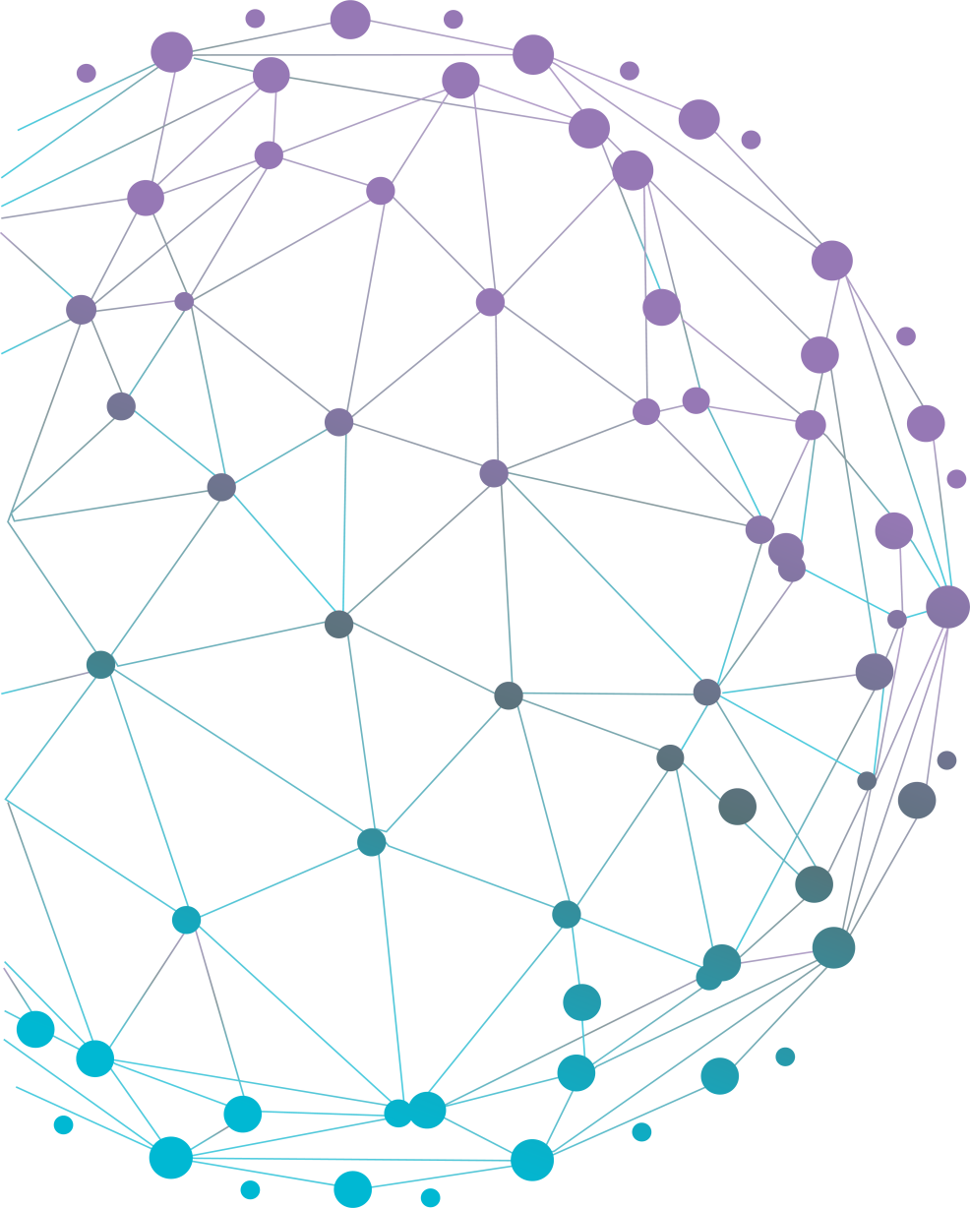
Engineering Knowledge Graph (EKG)
For all future innovations in engineering.
Notes:
I am Harsha. Basic introduction

Slide 3


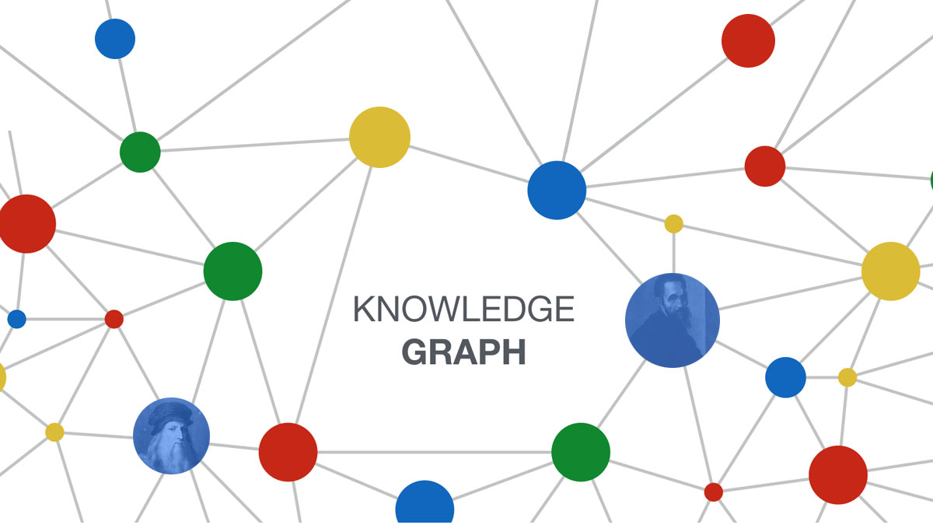



Knowledge graphs
A Knowledge Graph is a model of a knowledge domain created by subject-matter experts with the help of intelligent machine learning algorithms. It provides a structure and common interface for all of your data and enables the creation of smart multilateral relations throughout your databases. Structured as an additional virtual data layer, the Knowledge Graph lies on top of your existing databases or data sets to link all your data together at scale – be it structured or unstructured.

Slide 4
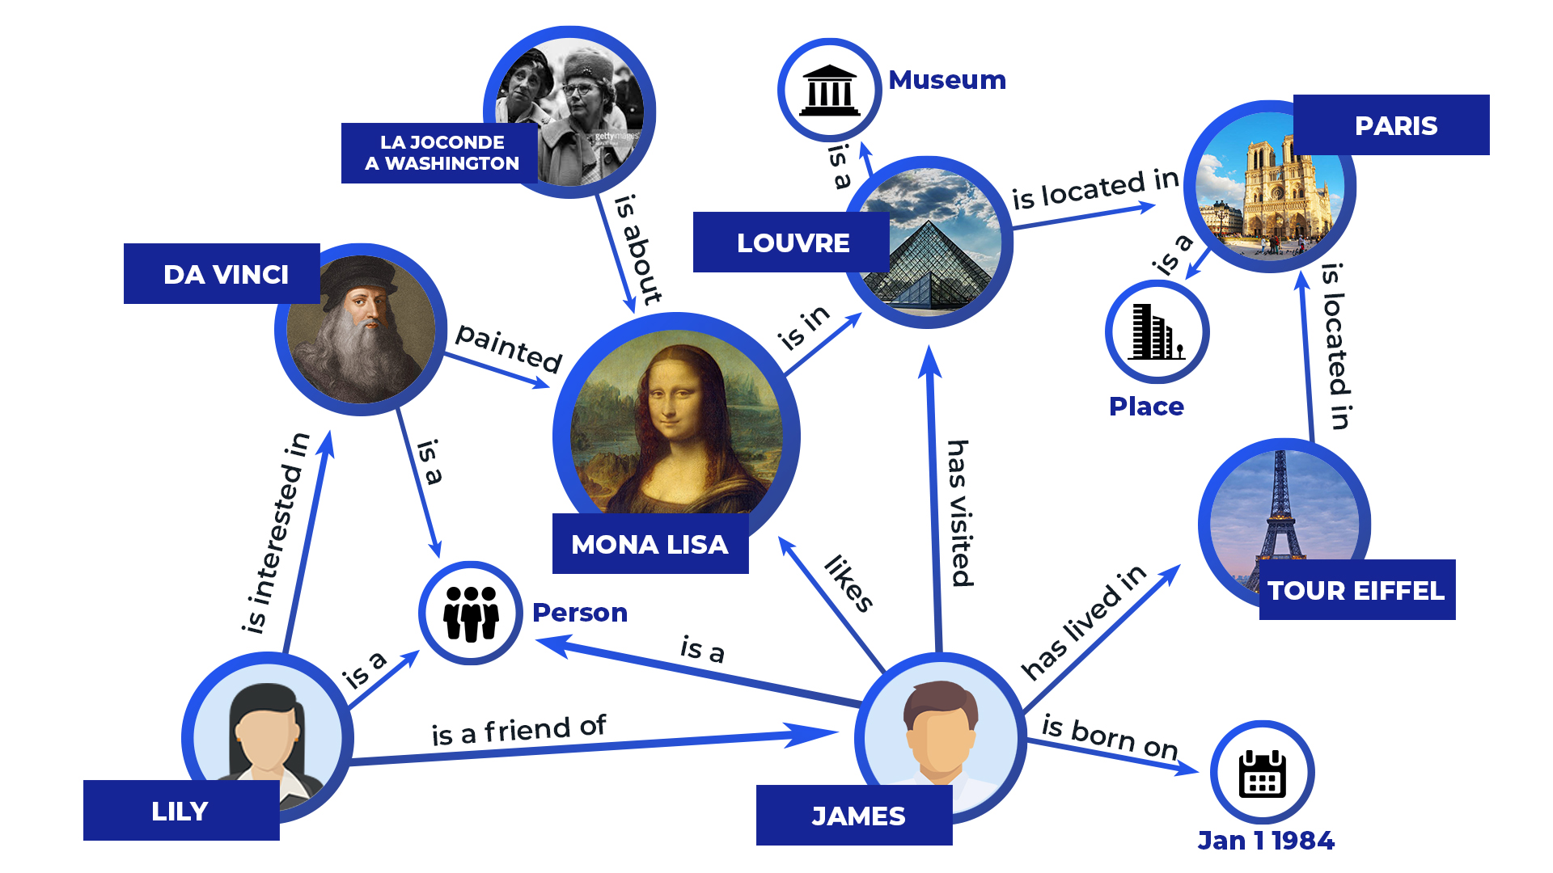
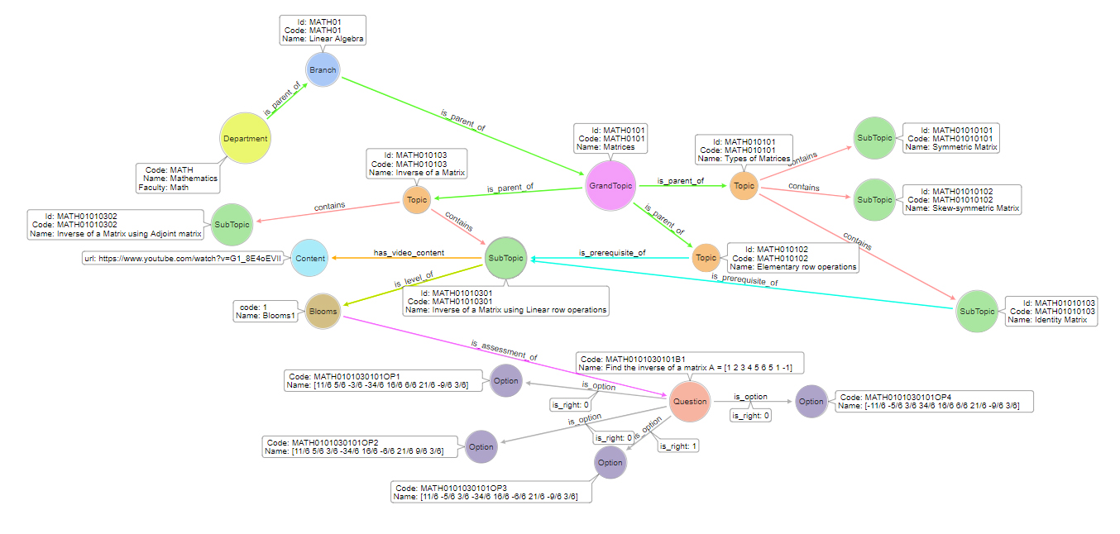

Notes:
Knowledge Graph intro: Before we get in to specifics, lets first understand what’s the knowledge graph exactly is.
These knowledge graphs are already part of our daily lives. Gool

Slide 5

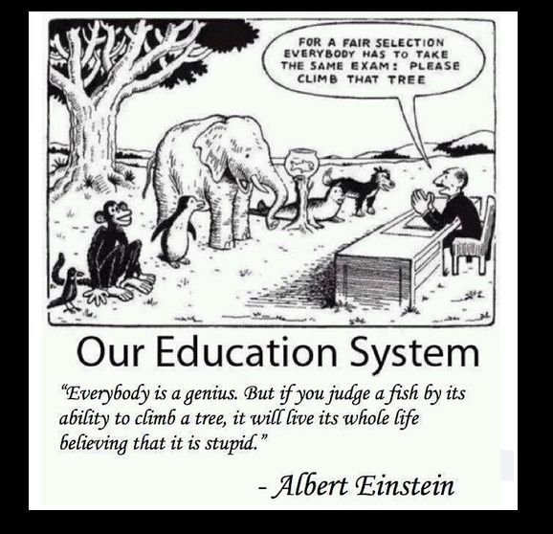
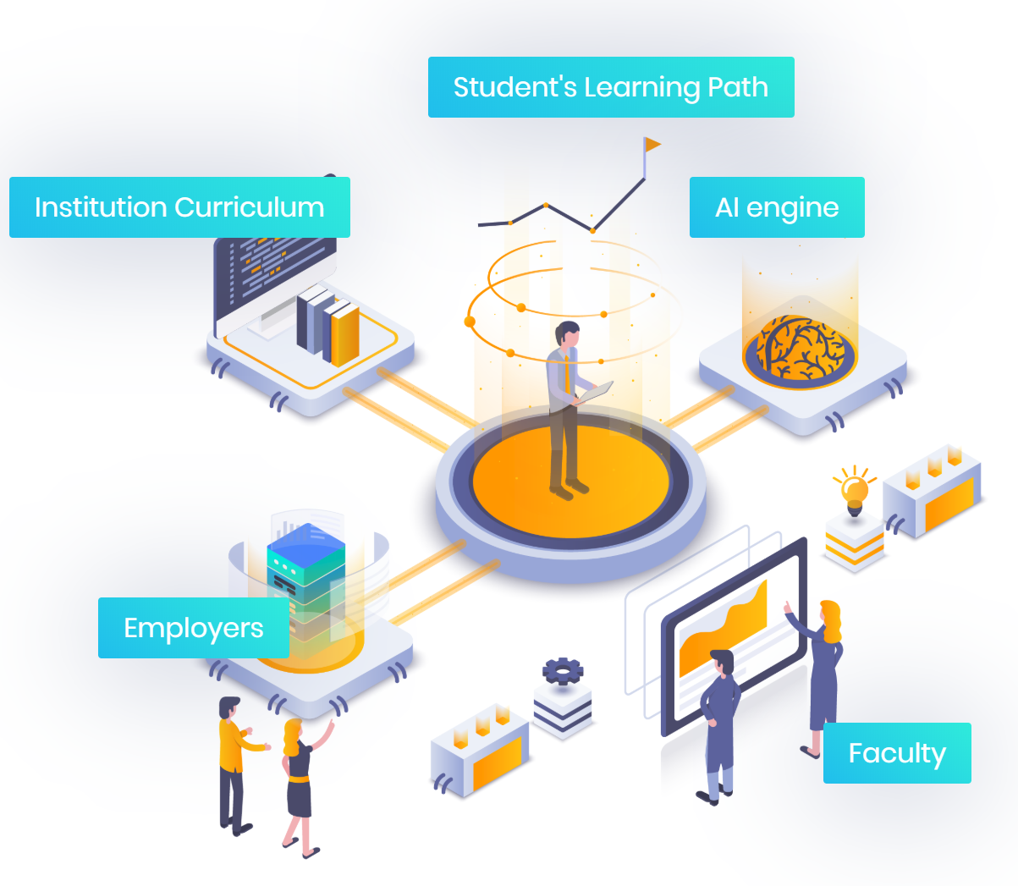
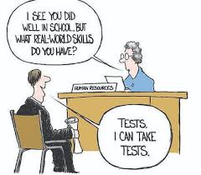
Necessity of EKG Framework
Are we able to focus on every individual Learner, monitor his learning styles/Patterns, strength, weaknesses, conceptual learning etc.,
Can we create a experiential learning within the scope of institutional curriculum.
At a highest level, are we able to bring all learners from multiple institutes under same umbrella
Learner is the core of any education system &
Educator being the facilitator of education.

Slide 6
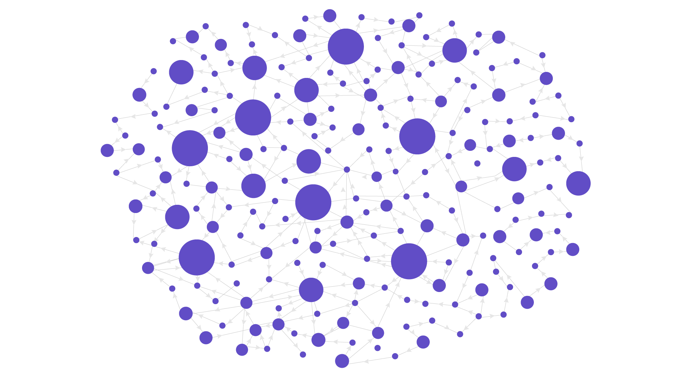
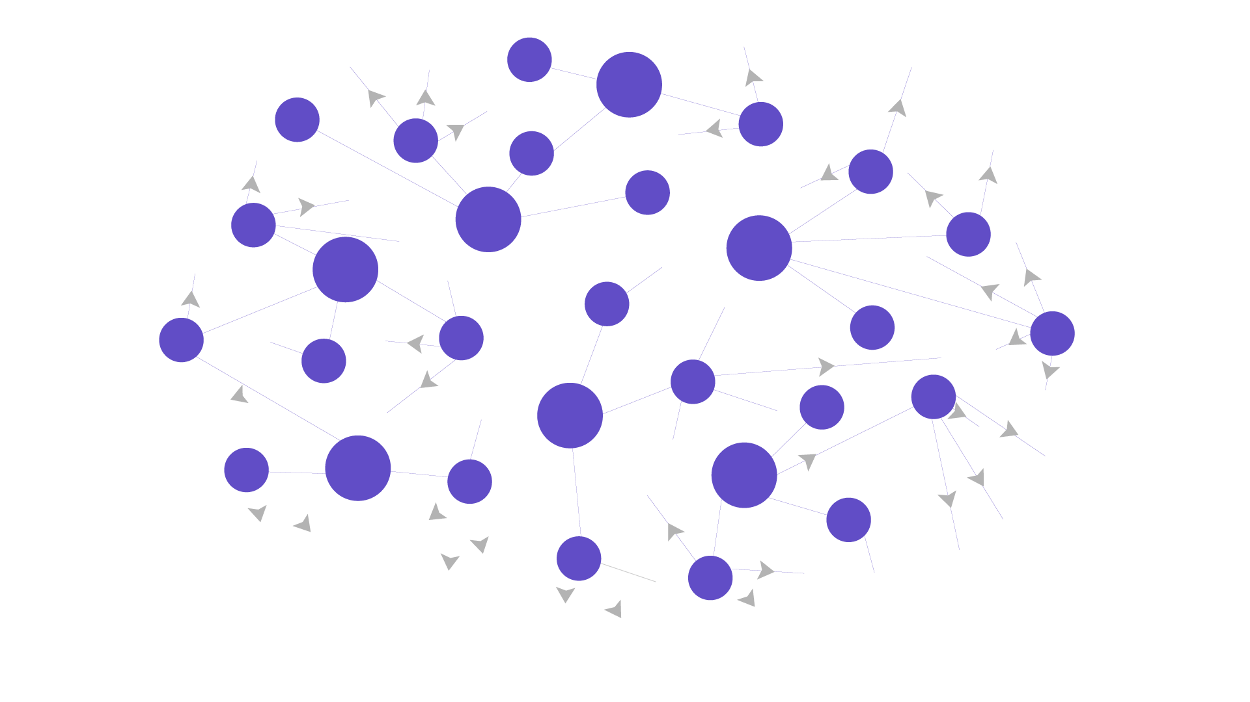
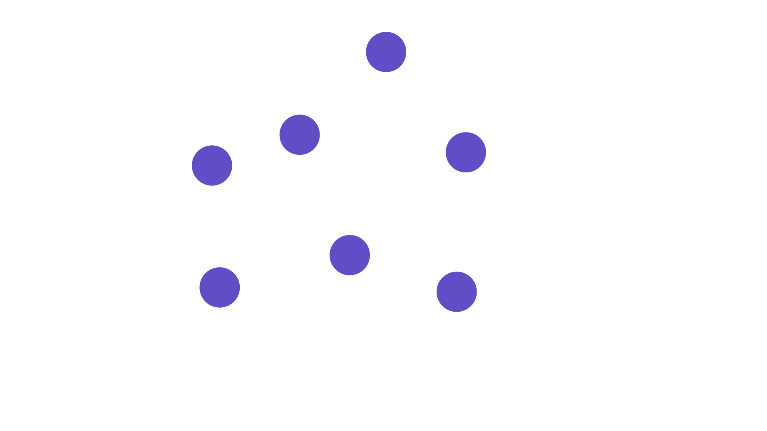
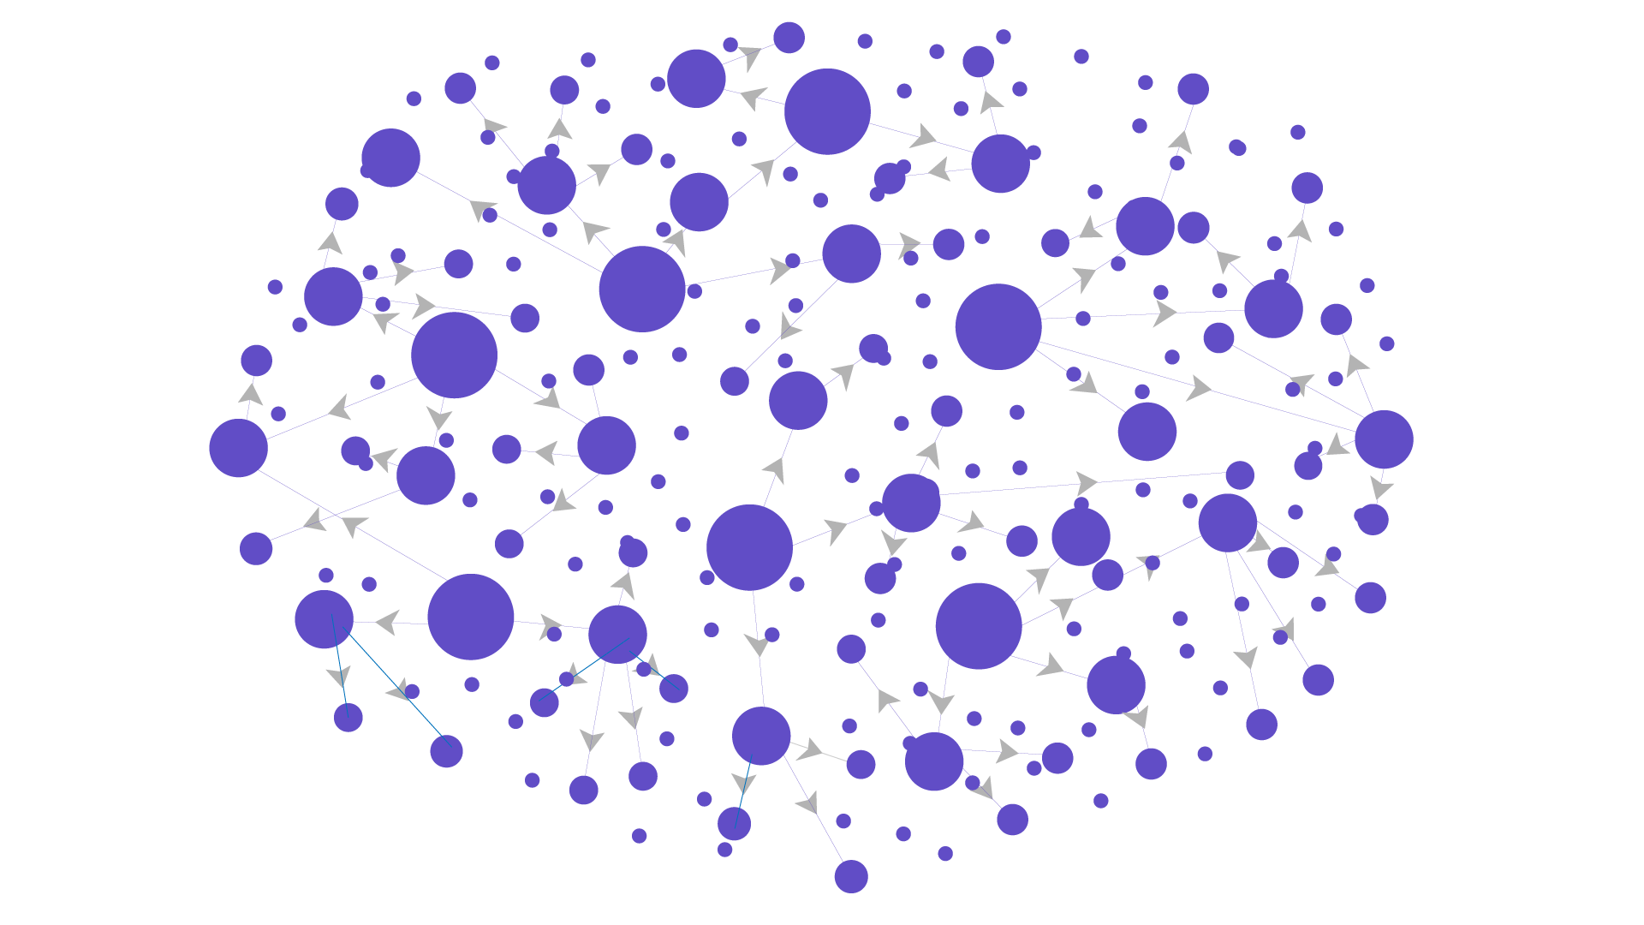
Building Engineering Knowledge graph
Indexing
Grand Topic
Topic
Sub-Topic
Super Subtopic
Fundamental Math/Science
Mapping/Interlinking
Reference : Model Curriculum AICTE 2018, IIIT’s, JNTU, GTU ..

Slide 7

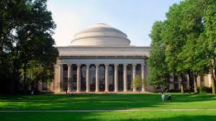
With multi-facets of learning, EKG becomes the base for all our future innovations in learning and student outcomes
EKG
Description
Learning Objective
Learning Outcome
Prepare
Advanced Topics
Applications
Massachusetts Institute of Technology, Boston
is a partner in building EKG
Related Topics
5
Disciplines
15000+ Concepts
45000+
Linkages
2 Million
Nodes
Assessments
Notes:
MIT Crosslinks is a partner in building EKG
Neo4j Browser
http://13.233.224.190:7474/browser/
https://13.235.111.252:7473/browser/
letmein
S
Edwisely OpenWIki
https://edwisely-concept-map.edwisely.now.sh/node?code=D02B03&type=GBranch

Slide 8
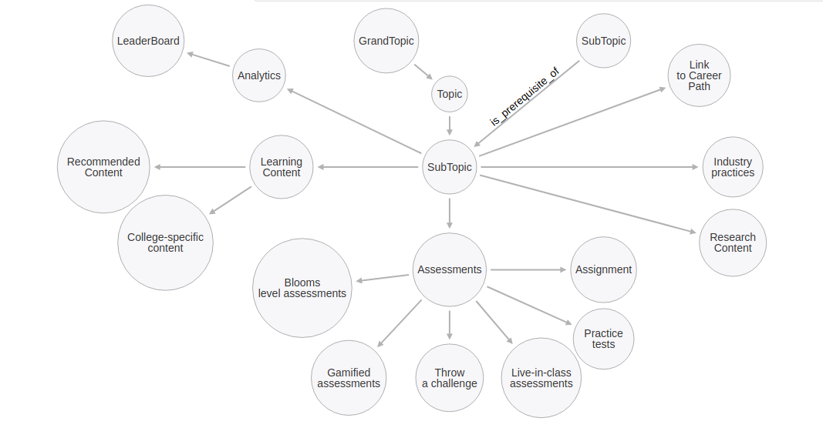
Nodal
Relationships
Is_prerequisite_of
Is_parent_of
has_video_content
has_document
Is_level_of
Is_option
has_research_content
Learning activities and parameters mapped at Sub-topic Level

Slide 9
Customize the EKG as per your curriculum EKG benefits across the university from day 1 Empowers the faculty & Students towards better outcomes. Create a scope of personalized learning within in the framework of your curriculum Have a strong backbone for all learning innovations through EKG
Customize EKG as per your Curriculum

Slide 10
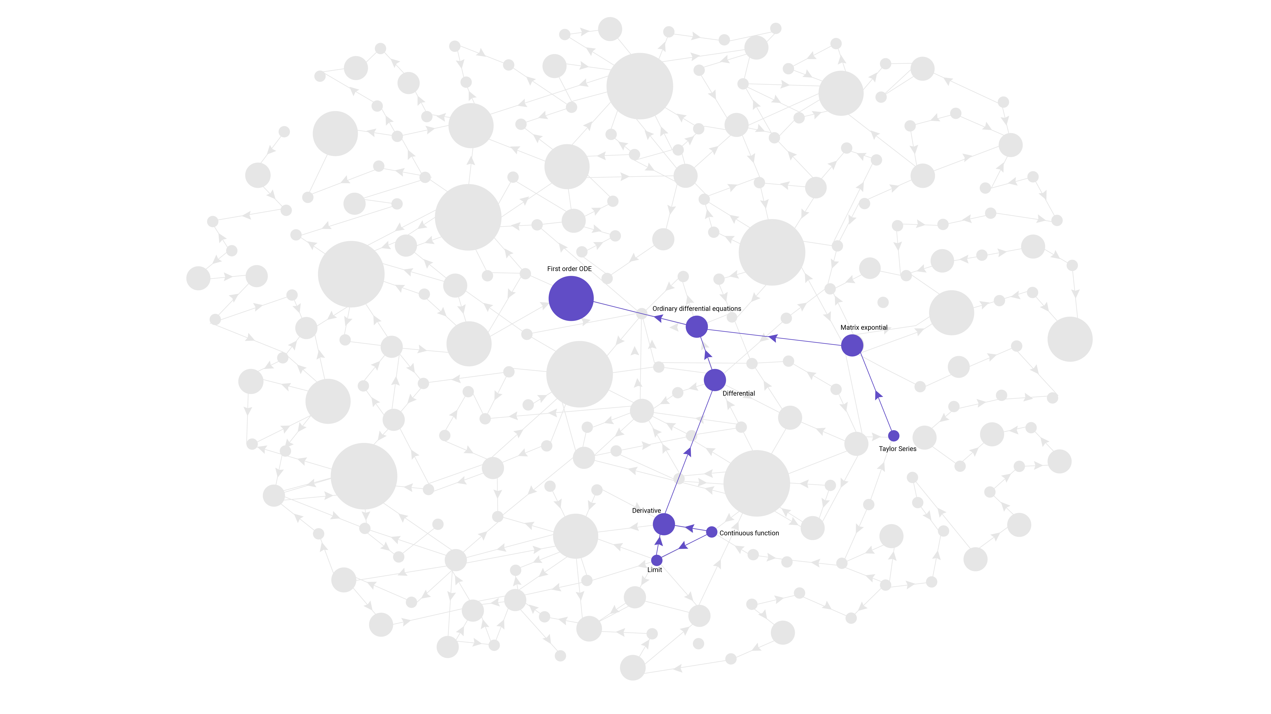
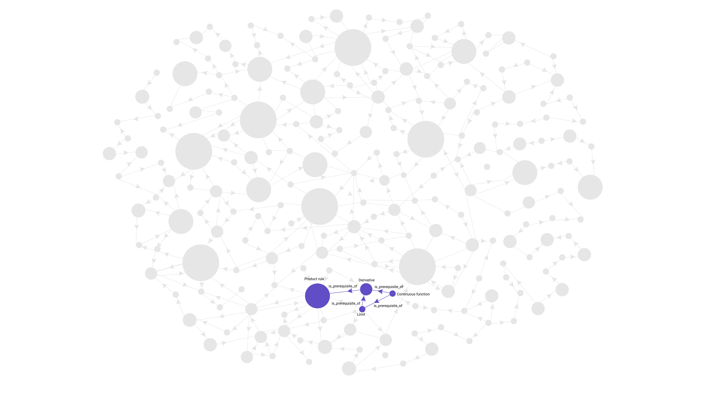
Making Learning Personalized
Institutes can now innovate towards personalization in learning with EKG
Understand the Prerequisite knowledge required
Create a learning path
Make your learning Adaptive
Learning Path charted based on Short Term and Long Term Growth Aspirations
Personalization through Step-wise Continuous Learning and Assessments

Slide 11
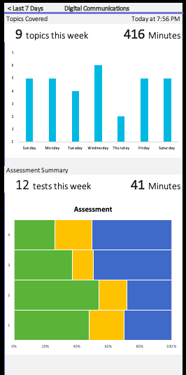
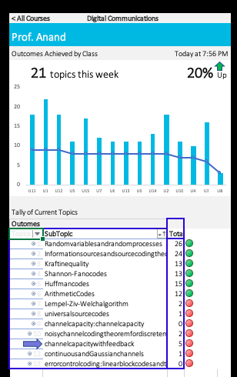
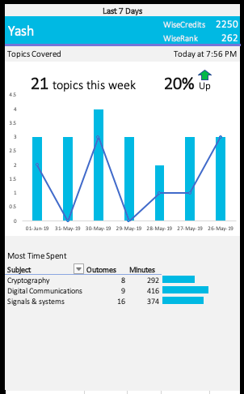
Universities, Institutes, Departments or faculty will now have detailed learning analytics Learning gaps can be analysed and addressed in realtime, thus by increasing the learning Outcomes. Multiple KPI’s can be monitored LIVE.
Dashboards for Realtime Analytics

Slide 12

RP
GO
PR
TLR
Engineering Knowledge Graph

Slide 13

THANK YOU

